Slide 1
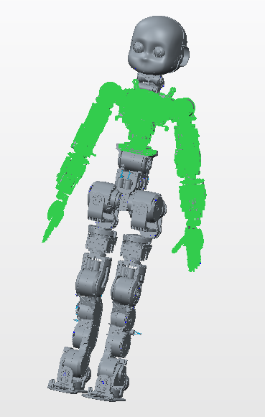
iCub3 Upperbody joints specs
Rev. 1
14/07/2016

Slide 2
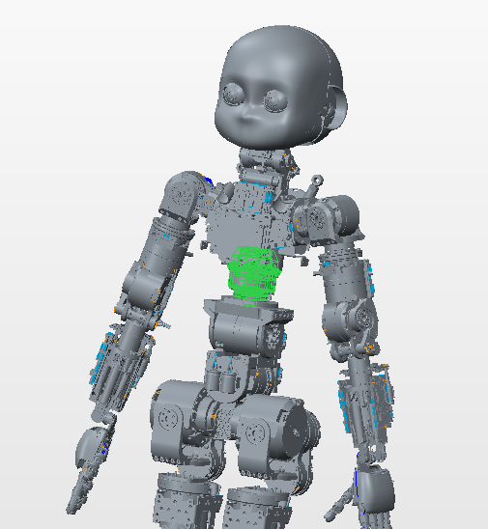
JOINTS 0– Upperbody yaw
-Motor type: Brushless C2900576 8 poles
-Lcore optical encoder on motor shaft
-Harmonic drive: 1/100
-Magnetic encoder & AMOboard at the joint
-HW limits (±45°)

Slide 3
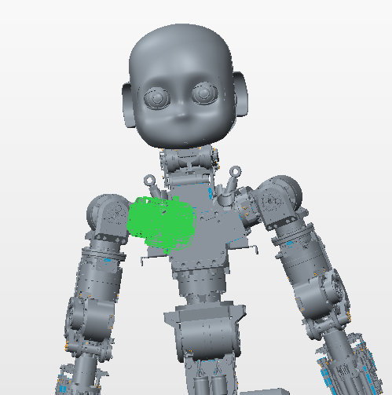
JOINTS 1– Shoulder pitch
-Motor type: Brushless C2900576 8 poles
-Lcore optical encoder on motor shaft
-Harmonic drive: 1/100
-Magnetic encoder & AMOboard at the joint
-HW limits -5° +100

Slide 4
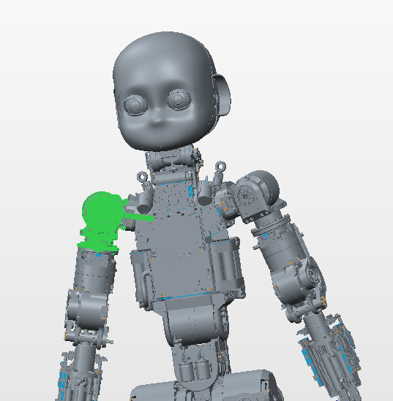
JOINTS 2– Shoulder roll
-Motor type: Brushless C2900576 8 poles
-Lcore optical encoder on motor shaft
-Harmonic drive: 1/100
-Magnetic encoder & AMOboard at the joint
-HW limits roll (-15° +150°)

Slide 5
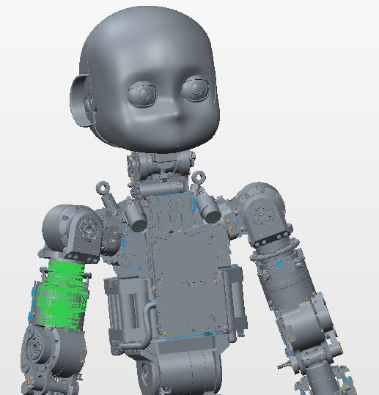
JOINTS 3– Upperarm yaw
-Motor type: Brushless C2900575 8 poles
-Lcore optical encoder on motor shaft
-Harmonic drive: 1/100
-Magnetic encoder & AMOboard at the joint
-HW limits roll (-52° +82°)

Slide 6
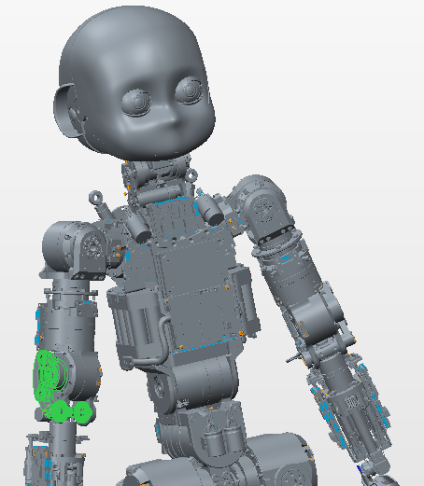
JOINTS 4– Elbow
-Motor type: Brushless C2900575 8 poles
-Lcore optical encoder on motor shaft
-Harmonic drive: 1/100
-Magnetic encoder & AMOboard at the joint
-HW limits roll (-5° +115°)

